Slide 1



Inclusive School Program Details
Dates
  During School terms, 8 weeks - exact dates TBD, Flexible dates and times to be negotiated between School and SRV
Location
  Delivered at your School
Target Participants
  T-Ball – 5 - 12
  Progressive Baseball – 10 – 17
Cost
  $150 per participant
    Sibling discount available
    NDIS eligible
    Fair Play Vouchers
Program Inclusions
  Great Training Program delivered by qualified coaches
  Modified equipment to aid inclusivity and enjoyment
  Fun, Friendships, Music
  Sport specific training & games
  Equipment required to run session (nets, bats, balls, bases, gloves etc)
  Each child receives a free Cap

Slide 2
Typical Session Plan Weeks 1-8
*Note Children may have breaks as per their individual need throughout each session
Agility & Conditioning 20 Minutes
Ladder Run
Broad Jump
Agility Poles
Pushups
Situps
Eye training
Wheelchair friendly agility activities
Cue Cards & Ipad program used to support non verbal children
Technical Skills Training 20 Minutes
Hitting (stationary ball)
Hitting (moving Ball)
Throwing Mechanics
Fielding Technique (Groundballs)
Fielding Technique (Catching the ball)
Wheelchair friendly skill stations
Cue Cards and Ipad program used to support non verbal children
Game 20 Minutes
Group splits into two teams
2 Innings game consisting 10 minutes per innings
Players rotate positions each innings
Players reverse batting order second time through
Wheelchair friendly surface for games
Cue Cards & Ipad program used to support non verbal children

Slide 3
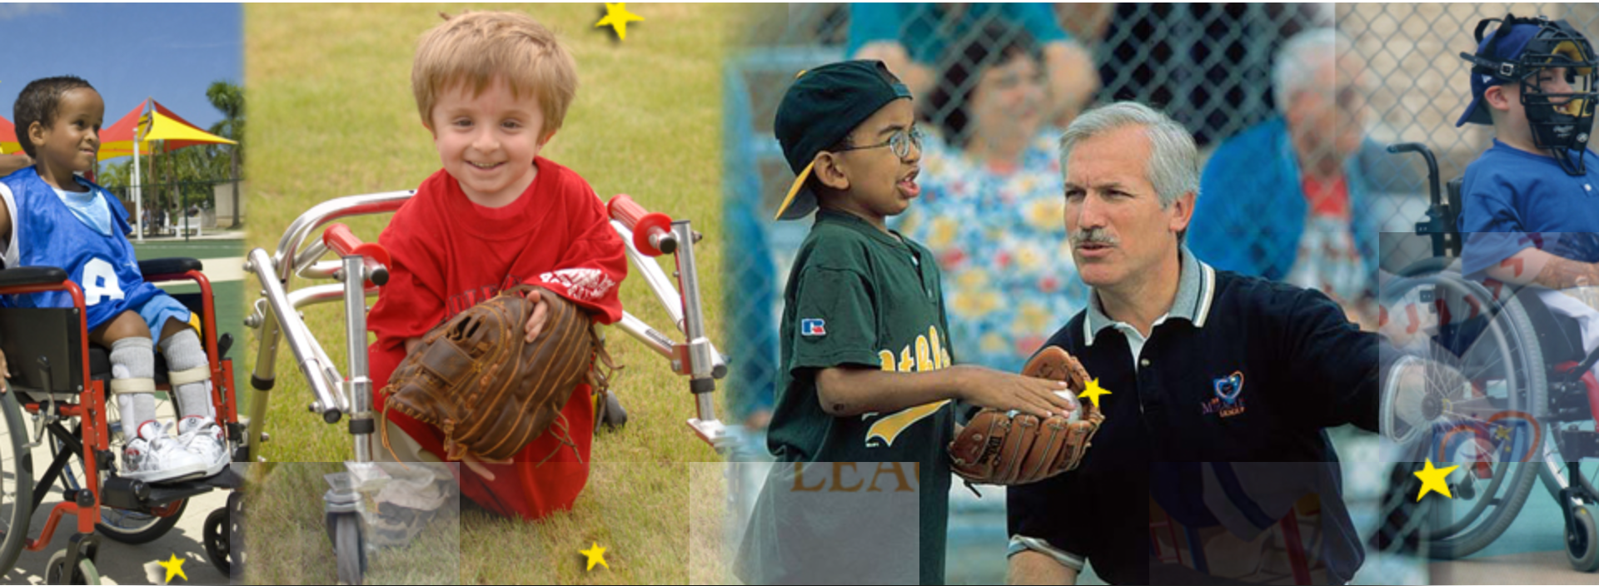
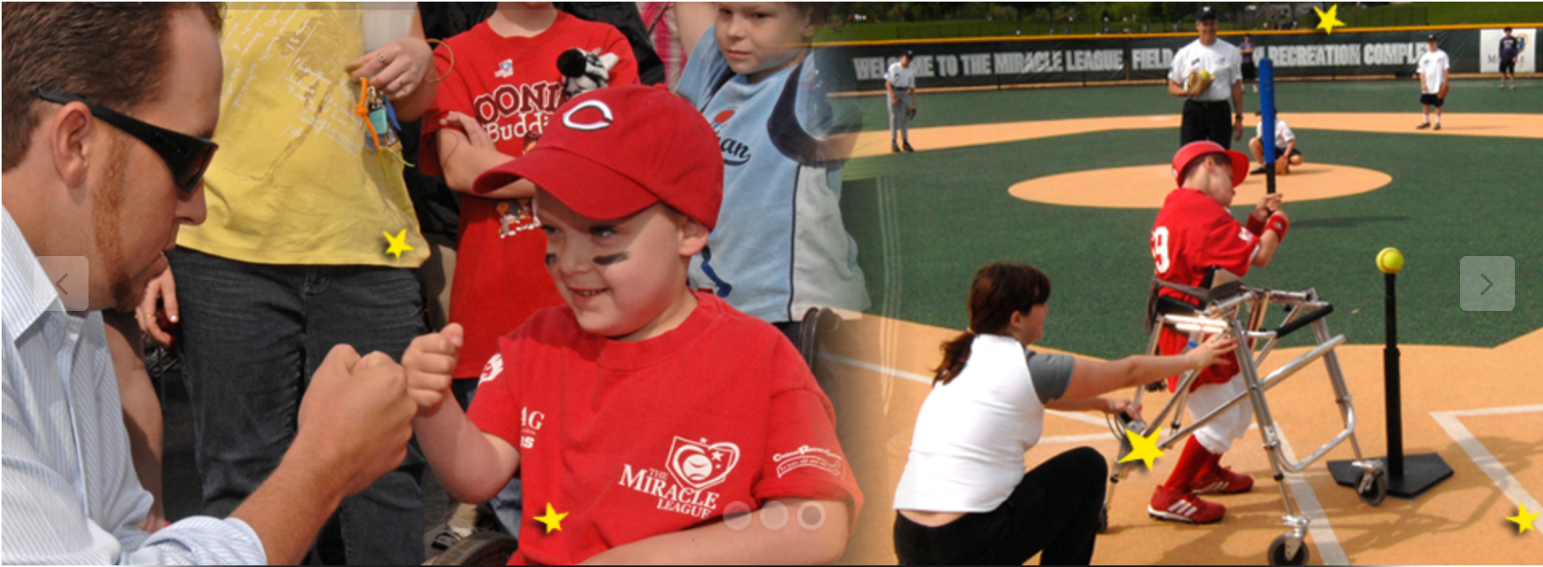

Slide 4
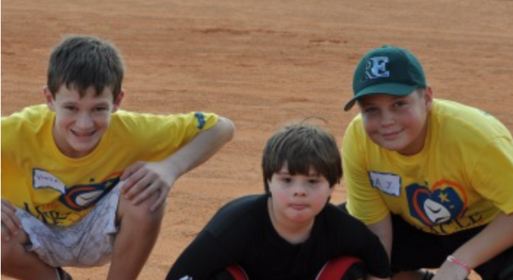
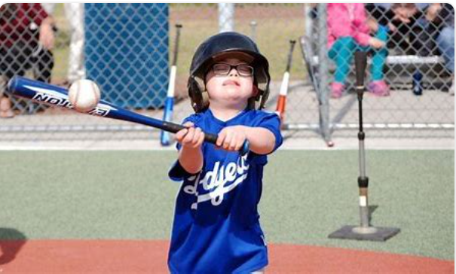
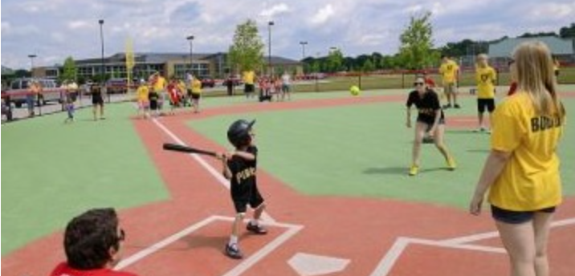


Slide 5
