Slide 1



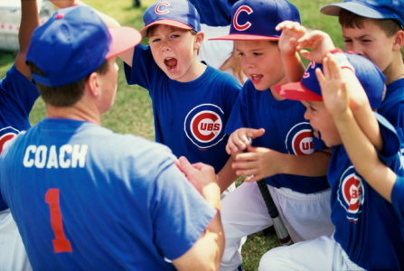
School Program Details
Dates
During School terms, - exact dates TBD, Flexible dates and times to be negotiated between School and SRV
Location
Can be delivered at your school or alternatively at the nearest baseball club
Target Participants
T-Ball – 5-7 year olds
RookieBall – 8-10 year olds
Little League 11 – 12 year olds
Program Inclusions
Great Training Program delivered by qualified high performance coaches
Fun, Friendships, Music
Sport specific training & games
Equipment required to run session (nets, bats, balls, bases, gloves etc)
Each child receives a free Cap

Slide 2


SRV Governance
SRV Baseball Australia is a not-for-profit organization authorized to deliver T-Ball programs through Baseball Australia and the Sporting Schools program.
SRV Management & Coaches have Blue Cards & manage currency through our online Blue Card Services Portal.
SRV Coaches have coaching qualifications & experience delivering our programs and Baseball Queensland Programs
SRV has current Public Liability Insurance up to $20 million
SRV has significant experience & great feedback delivering Baseball programs into schools in Brisbane

Slide 3
Session Plan Weeks 1-4
Agility & Conditioning 20 Minutes
Ladder Run
Broad Jump
Agility Poles
Pushups
Situps
Timed Sprint
Eye training
Technical Skills Training 20 Minutes
Hitting (stationary ball)
Hitting (moving Ball)
Throwing Mechanics
Throwing Velocity Measured
Fielding Technique (Groundballs)
Fielding Technique (Catching Flyballs)
Game 20 Minutes
Group splits into two teams
2 Innings game consisting 10 minutes per innings
Players rotate positions each innings
Players reverse batting order second time through

Slide 4

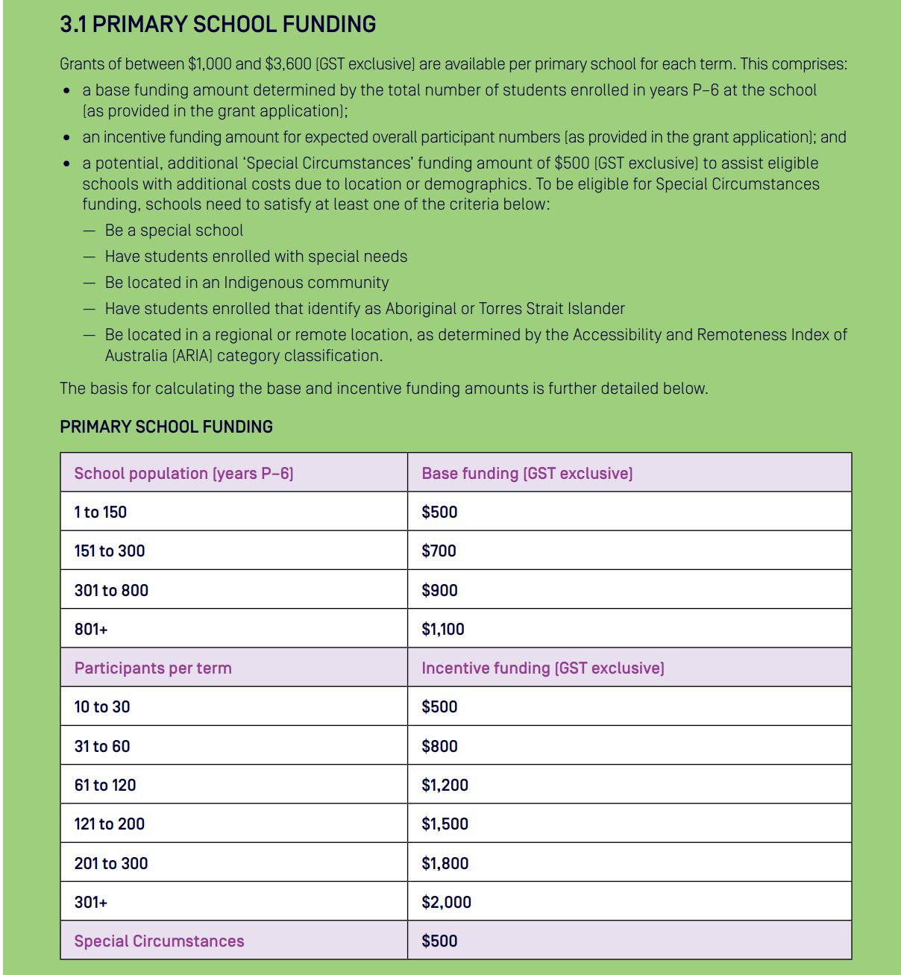
Financials: 4 Week Program

